Slide 7
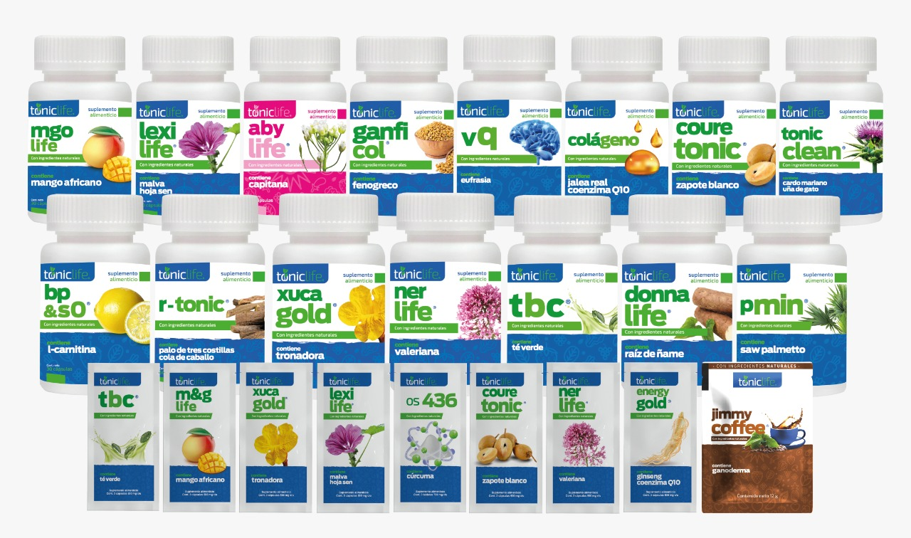

Slide 12
$970 USD.

Slide 14
$1275 USD
($1000 USD)
($150 USD)
($187.5 USD)
($937.50 USD)

Slide 15
($180 USD)
($375 USD)
($ 937.50 USD)
($4687.50 USD)
($23,437.50 USD)
($117,187.50 USD)

Slide 16
($250 USD HASTA $1400 USD)

